Slide 1

Change me to a picture!
#GlobalVolunteerMonth
The Impact
of Volunteering
YOUR LOGO

Slide 2



What is Global Volunteer Month?
Global Volunteer Month runs throughout April. It is a global campaign organised by leading non-profit Points of Light which is being supported by many large organisations around the world.
It’s an opportunity to:
Celebrate our achievements
Show our
social impact
Get everyone involved
YOUR LOGO
#GlobalVolunteerMonth

Slide 3
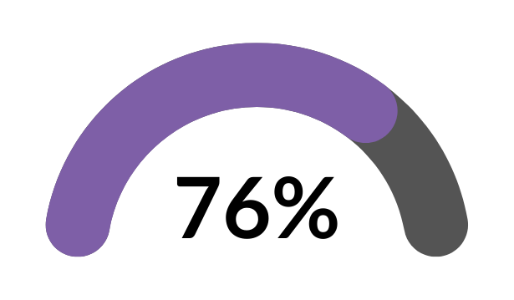

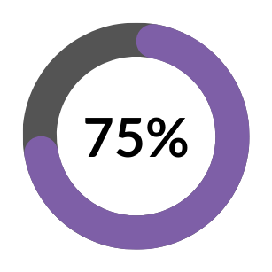
Delivering our corporate purpose by creating social impact
of customers are more
likely to trust a company
which leads with purpose.
Porter Novelli, 2021
Increase in job satisfaction reported by
employee volunteers compared to their non-volunteering colleagues.
Youth.gov
Nine in 10 charities rely solely on the work of volunteers to keep going.
Beyond Profit, 2021
YOUR LOGO
#GlobalVolunteerMonth

Slide 4



How we have created social impact in 2023
xxxx
hours spent
volunteering
xxxx
projects
completed
xxxx
people
impacted
YOUR LOGO
#GlobalVolunteerMonth

Slide 5
A big thank you to our top volunteers!
First Name
Last Name
CHANGE ME TO AN IMAGE!
FOR COMPLETING
[INSERT NUMBER]
VOLUNTEERING HOURS
YOUR LOGO
#GlobalVolunteerMonth

Slide 6
A big thank you to our top volunteers!
CHANGE ME TO AN IMAGE!
CHANGE ME TO AN IMAGE!
CHANGE ME TO AN IMAGE!
First Name Last Name
First Name Last Name
First Name Last Name
[INSERT NUMBER]
VOLUNTEERING HOURS
COMPLETED
[INSERT NUMBER]
VOLUNTEERING HOURS
COMPLETED
[INSERT NUMBER]
VOLUNTEERING HOURS
COMPLETED
YOUR LOGO
#GlobalVolunteerMonth

Slide 7
It’s easy to get involved!
1
2
3
Log in to the Volunteering Hub
Browse available opportunities
Register for events and tasks
YOUR LOGO
#GlobalVolunteerMonth

Slide 8
#GlobalVolunteerMonth
We’ve got an exciting volunteering programme in 2024. See the new opportunities here!
Beneficiary
Opportunity
Type
XXX
Tree planting
In person
XXX
CV reviewing
Online
XXX
Maintenance and painting
In person
XXX
XXX
XXX
CHANGE ME TO AN IMAGE!
XXX
XXX
XXX
XXX
XXX
XXX
XXX
XXX
XXX
XXX
XXX
XXX
Get involved so you can make a difference!
YOUR LOGO

